Slide 1
Capstone Project Early Attrition Modelling For Clearwater State University By: Hitesh Kapade | GitHub Link

Slide 2
Table Of Contents
Project Description
Project Introduction
Objective
Methodology
Data Description
Data Preprocessing
Exploratory Data Analysis (Eda)
Data Transformation
Building Prediction Models
Key Findings
Recommendations

Slide 3
1. Project Description
Clearwater State University offers a wide variety of degree programs, from online degrees to a doctorate in education. Programs are offered in the streams of the arts, education, business & nursing.
Some key strategic goals of the University are:
Increase enrolment of students
Improve retention, progression and graduation rates
Recruit better academically qualified undergraduate and graduate students
Increase external funding and recognition

Slide 4
2. Project Introduction
The students’ early attrition has become one of the most challenging problems for academic institutions. The loss of students usually results in overall financial loss, lower graduation rates, and inferior reputation of the university in the eyes of stakeholders.
The principal motivations for improving student retention are the economic and the social benefits of attaining a higher education degree both for individuals and for the public.
The student attrition at a university has been defined as the number of students who do not complete a degree in that institution. Since most of the student dropouts occur at the end of the first year, the majority of student attrition studies have focused on first year dropouts or the number of students not returning for the second year.

Slide 5
3. Objective
The objective of this project is to build predictive models to identify students with higher early attrition risk and recommend appropriate interventions based on the analysis.
For this project, we have used the data of the past students of Clearwater State University along with four popular data mining techniques – Logistic Regression, Random Forest, Gradient Boost, and Extreme Gradient Boost (XGBoost) to develop the predictive to predict early attrition.
In order to identify the important predictors, we conducted exploratory data analyses and feature importance using these models.

Slide 6
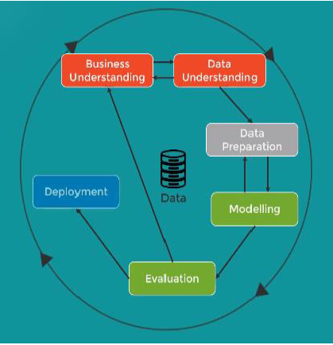
4. Methodology
For this project, we use the data mining methodology called CRISP-DM (Cross Industry Standard Process for Data Mining). Crisp DM is a process model that provides a fluid framework for devising, creating, building, testing and deploying ML solutions. It has the following six steps:
Business Understanding: understanding the domain and developing the goals for the study
Data Understanding: identifying, accessing and understanding the relevant data sources
Data Preparation: pre-processing, cleaning, and transforming the relevant data
Modelling: developing models using comparable analytical technique
Evaluation: evaluating and assessing the validity and the utility of the models against each other and against the goals of the study
Deployment: deploying the models for use in decision- making processes

Slide 7
5. Data Description
The dataset given for this project has records of 3400 students for the academic years 2005 to 2011 with 56 different attributes including the output variable RETURNED_2ND_YR which indicates whether the student came back to first semester in second year. We have divided these attributes of the students can be divided into the following four high level categories:
Student Application data
Financial Indicators
Course Preferences
Performance Record
The dataset was assessed and pre-processed to identify and remove anomalies and unusable records. For example, we removed STUDENT IDENTIFIER from the dataset because it had all the unique values, since it will not help us in building model. Also, changed the target variable STDNT_EARLY_ATTRITION to reflect the objective more clearly. Additionally, derived some new variables using existent variables to help reduce the redundancy.

Slide 8
6. Data Preprocessing
In order to clean the dataset we performed the missing value & outliers imputation with the appropriate values.
Missing values imputation:
We dropped the columns where missing values are close to 50% of the total values. For the remaining columns, we imputed the missing value with the suitable values like mean, mode, or median of the observed values.
Handling Outliers:
Outliers may introduce noise into the final model. Thus, we have imputed the outliers using the suitable values.

Slide 9
7. Exploratory Data Analysis (EDA)
We performed Exploratory data analysis (EDA) to analyze datasets and summarize their main characteristics. In order to perform the EDA efficiently we divided the given features into the following categories:
Student Application data | Performance Indicators | Course Preferences | Financial Indicators
STDNT_AGE STDNT_GENDER STDNT_BACKGROUND IN_STATE_FLAG INTERNATIONAL_STS STDNT_TEST_ENTRANCE_COMB HIGH_SCHL_GPA HIGH_SCHL_NAME FATHER_HI_EDU_CD MOTHER_HI_EDU_CD | STDNT_ACADEMIC_YEAR HOUSING_STS DISTANCE_FROM_HOME DEGREE_GROUP_CD STDNT_MAJOR STDNT_MINOR FIRST_TERM_PERCENTAGE SECOND_TERM_PERCENTAGE | CORE_COURSE_NAME_1_F CORE_COURSE_GRADE_1_F CORE_COURSE_NAME_2_F CORE_COURSE_GRADE_2_F CORE_COURSE_NAME_3_F CORE_COURSE_GRADE_3_F CORE_COURSE_NAME_1_S CORE_COURSE_GRADE_1_S CORE_COURSE_NAME_2_S CORE_COURSE_GRADE_2_S CORE_COURSE_NAME_3_S CORE_COURSE_GRADE_3_S | EST_FAM_CONTRIBUTION UNMET_NEED COST_OF_ATTEND

Slide 10
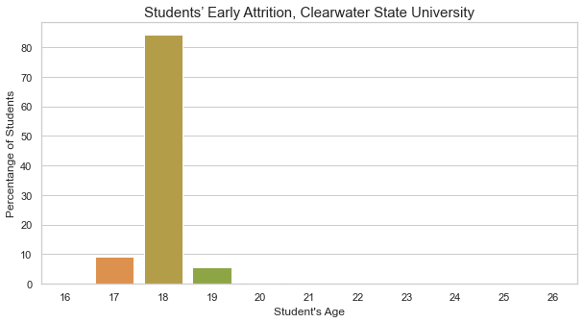
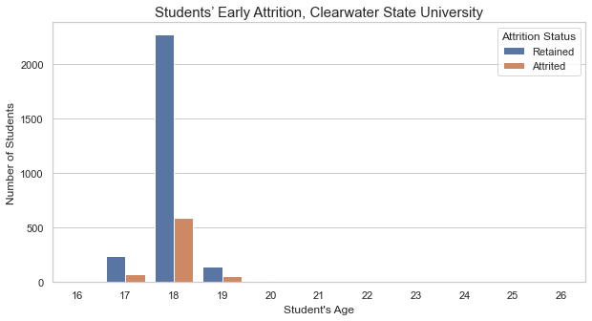
7.1 EDA: Student Application Data
More than 80% of the students are of the age 18, and 99% of the students are between 17 & 19. From the age group 17 to 19, more than 70% of the students came back for the second year. Also, as the age increases, rate attrition is also increasing.
The majority of the students is female. They corresponds to 63% of the total. Also, 78% & 80% of the females & males, respectively came back for the second year.
In the age group of 18, the % of females is significantly greater than males {64% & 36%}. Also, in the same age group the rate of attrition of female students is 22% whereas male students it is 19%. Overall as the age increases, the % of female students taking admission to university is decreasing. The average age of the male and female student is almost same.

Slide 11
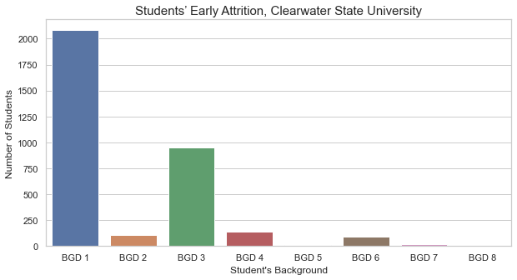
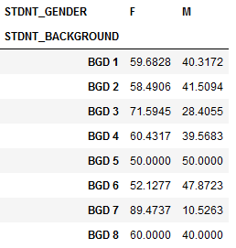
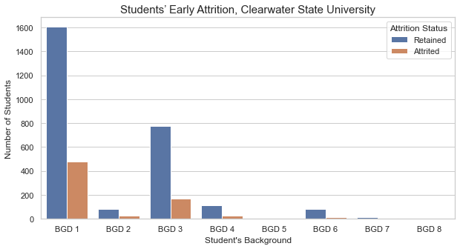
7.1 EDA: Student Application Data
Almost 90% of the students are from the background BGD 1 & 3. In both the cases, around 80% students came back for the second year.
Irrespective of the background the proportion of females is more than 50%.

Slide 12
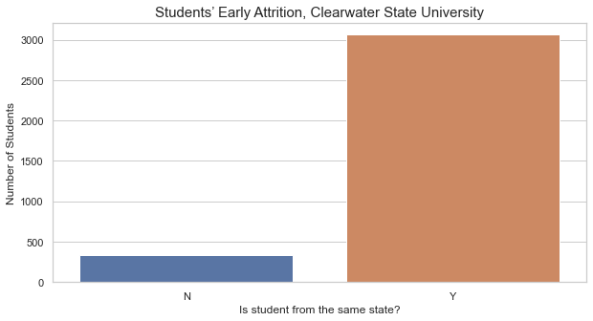
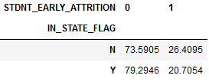
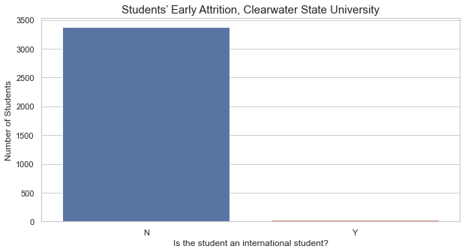
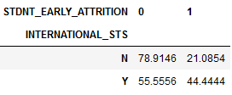
7.1 EDA: Student Application Data
90% of the students are from the same state as the university. The rate of attrition is slightly more in the students out of state {Rate of attrition - In State: Yes & No - 26% & 20%}.
The university has very negligible {less than 1%} international students. That means, this variable is not helpful for out model. Thus, we can drop this variable. Also, the average age of the international student is greater.

Slide 13
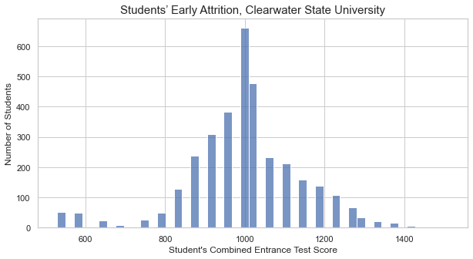
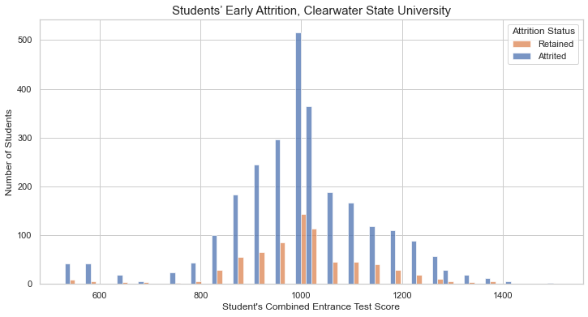


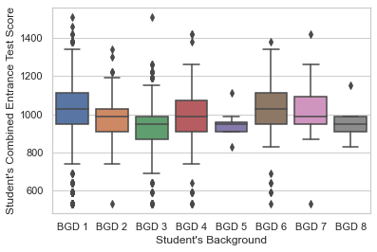
7.1 EDA: Student Application Data
The combined score of more than 50% of the students is between 910 & 1030 {910, 950, 990, and 1030}. The rate of attrition for these four categories is between 21% to 24%.
On an average male students tends to perform good in the entrance exam.
The students from background 1, 6, and 7 tends to perform good in the entrance exam.

Slide 14
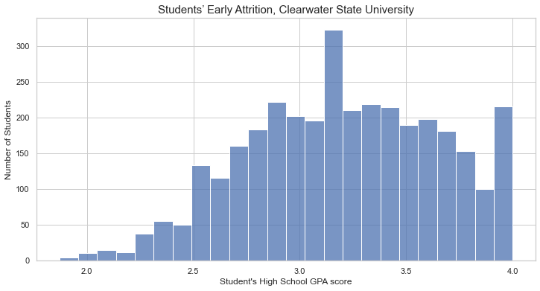
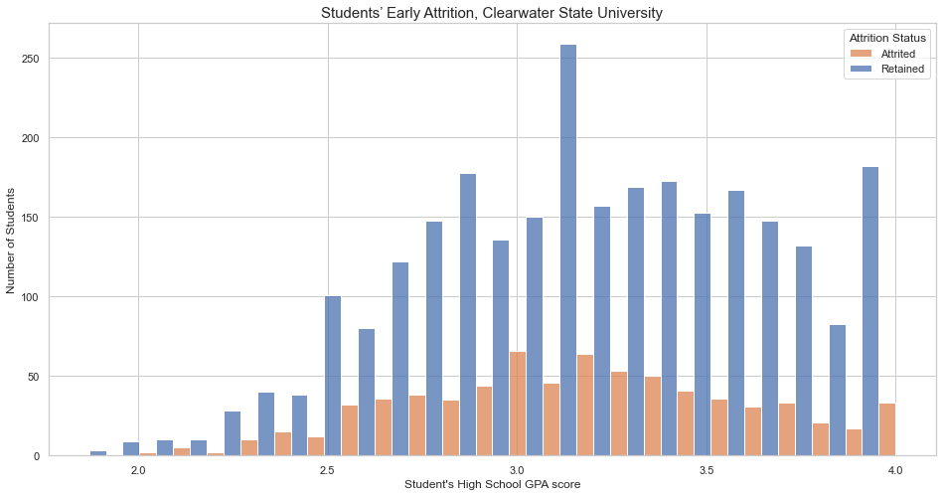


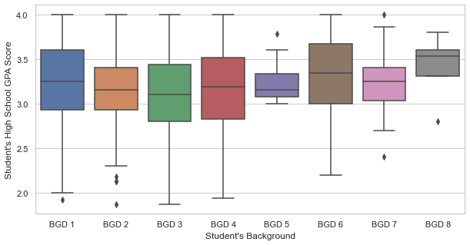
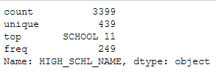
7.1 EDA: Student Application Data
The students having less High School GPA score tends to attrite.
The female students have more average High School GPA score than male students.
HIGH_SCHL_NAME has lot of unique values. That means, this variable is not helpful for out model. Thus, we can drop this variable.

Slide 15
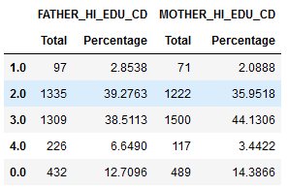
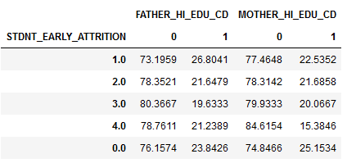
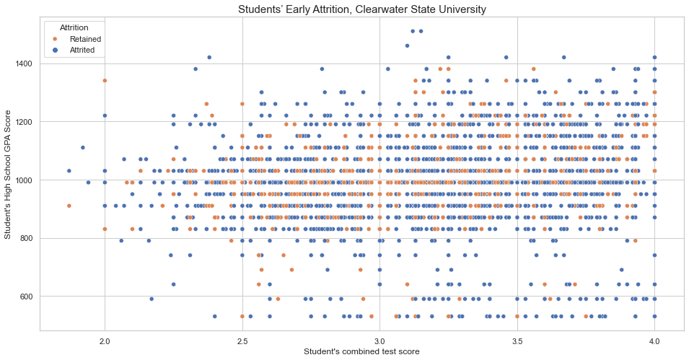
7.1 EDA: Student Application Data
There is no apparent relationship between HIGH_SCHL_GPA & STDNT_TEST_ENTRANCE_COMB.
There are 78% students whose parents are either High School or College/Beyond pass outs. Also, the attrition rate is more where the parents education is high school or less.

Slide 16
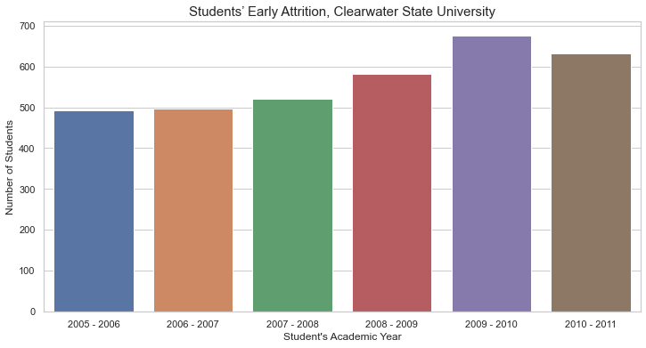
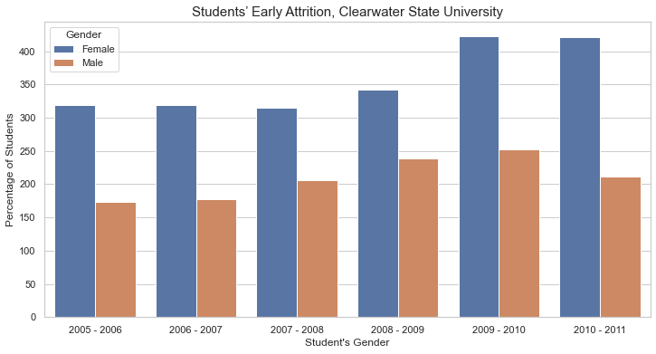
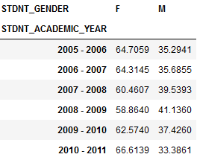
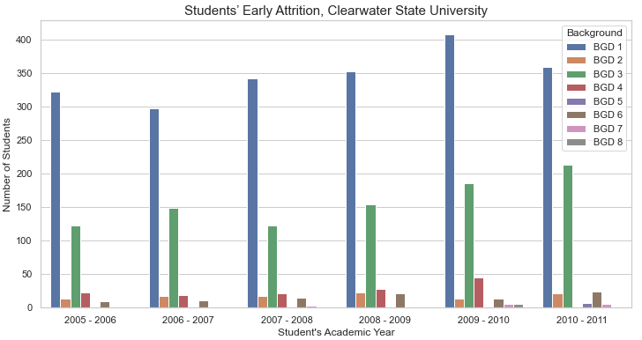
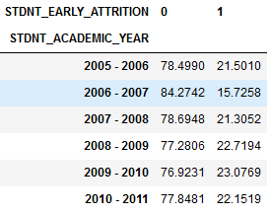
7.2 EDA: Performance Indicators
The academic year 2009-2010 has the most number of students in the university. There is a linear increase in the number of students. The academic year 2006-2007 has the least attrition rate {16%}.
The ratio of the gender is almost the same across the academic years. The rate of attrition in females is more than males
The enrolment of students from background 3 is increasing consistently.

Slide 17
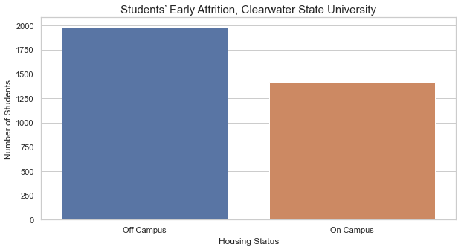
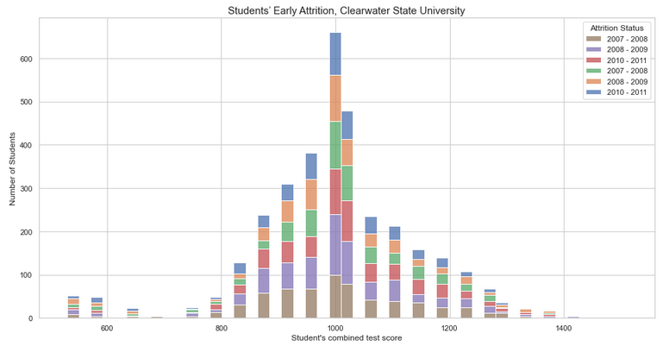
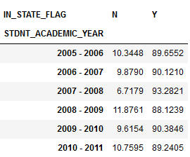
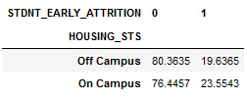
7.2 EDA: Performance Indicators
In each academic year almost 90% of the students are from the same state.
Every year most number of students admitted to university has scored 990.
Around 59% of the students prefer to live off campus. The attrition rate among the students living on campus is more.

Slide 18
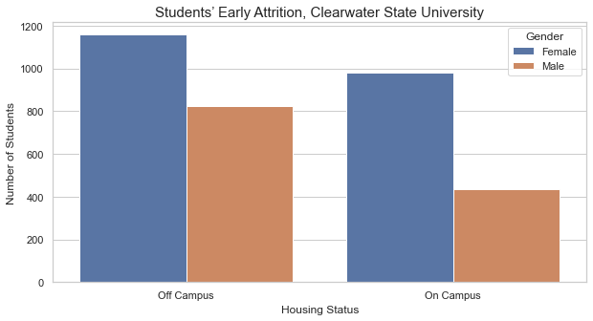
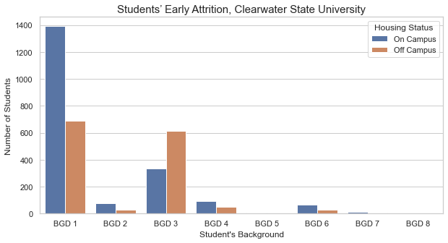
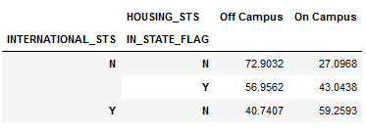
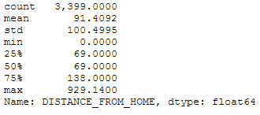

7.2 EDA: Performance Indicators
Most of the female students prefer to live on campus, whereas male students prefer to live off campus.
73% of the outstation students & 57% of the locals are prefer to live off campus.
65% of the students from background 3 lives on campus.
The average distance between home and university is 91 kms. The distance might have influence on attrition, since the students attrite has home at a distance more than 100kms from university, on average.

Slide 19
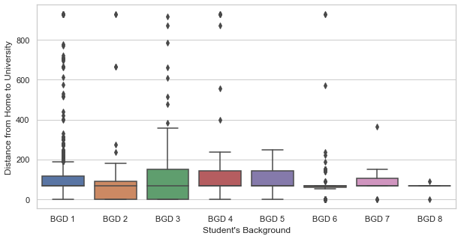
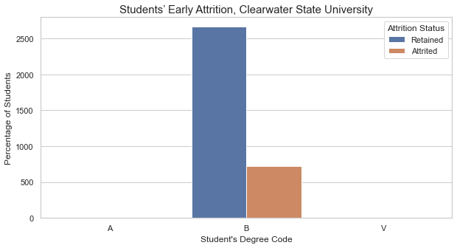
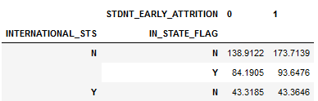

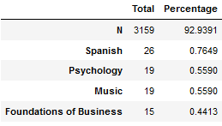

7.2 EDA: Performance Indicators
The students from background 4 & 5 has to home more than 100kms from university.
The out of state students have an average distance of 147kms whereas the students living in the same state have an average distance of 86kms.
99.5% of the data is of only one type. There no variation as such. That means, this variable is not helpful for out model. Thus, we can drop this variable.
Almost 93% of the data is of only one type. There no variation as such. That means, this variable is not helpful for out model. Thus, we can drop this variable.

Slide 20
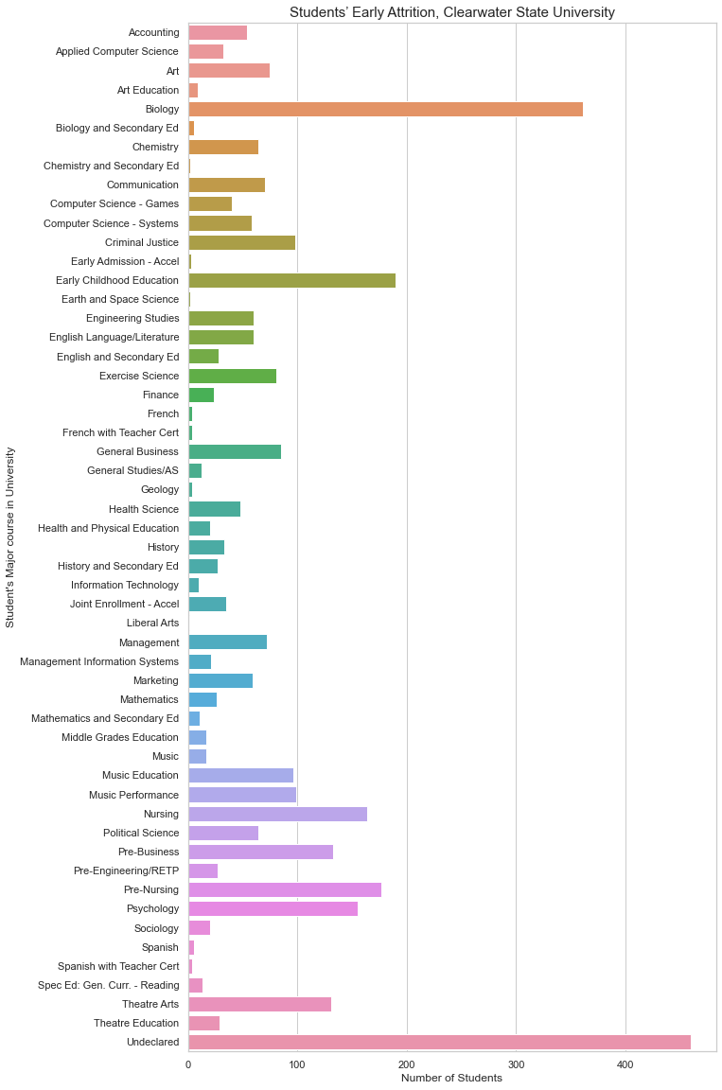
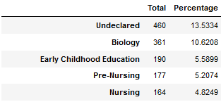
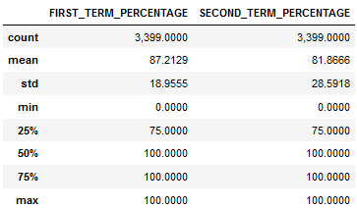
7.2 EDA: Performance Indicators
We don't know the major course of 13.5% of students. The most popular course is biology with the rate of attrition with 23%.
The average of the students is decreased in the second term. In the first term 60% of the students earned 100% grade points whereas in the second it was 57.5%. Also, in the second terms almost 7% of the students got 0%.

Slide 21
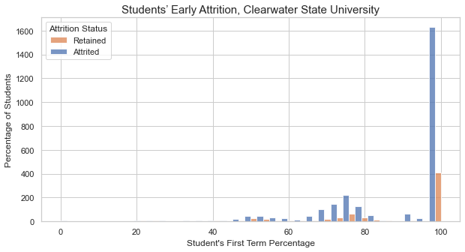
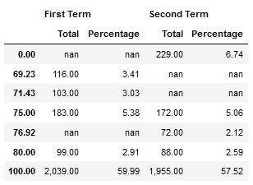
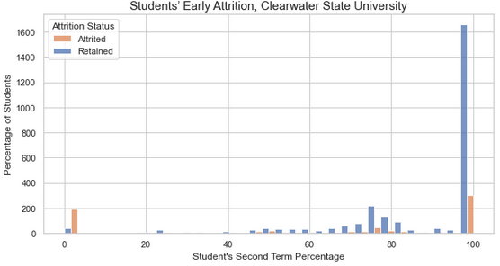
7.2 EDA: Performance Indicators
20% of the students who scored 100% in the first term, attrited. On an average female students scored well compare to male students.
15% of the students who scored 100% in the first term, attrited. Also, in case of the students who scored 0%, the rate of attrition is 83%.

Slide 22
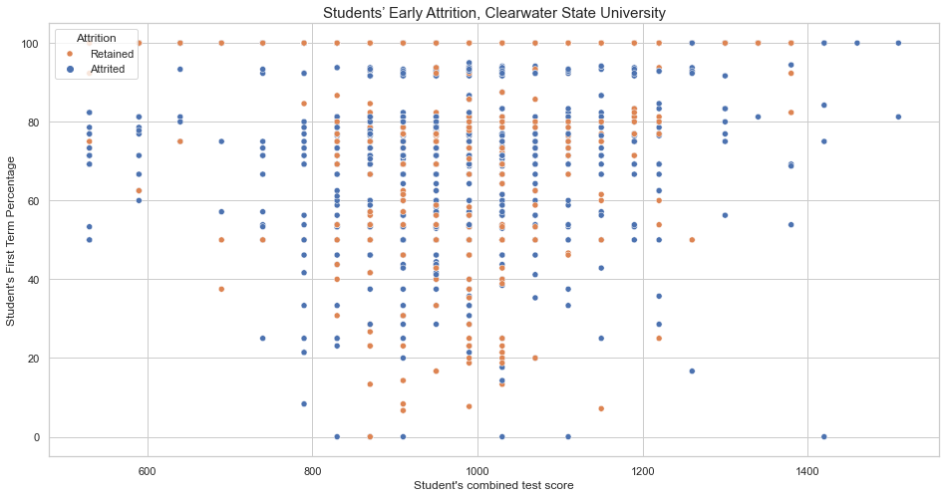
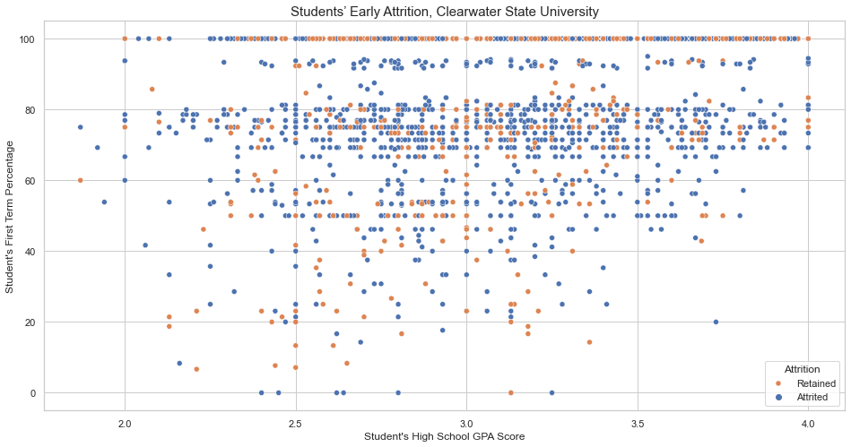
7.2 EDA: Performance Indicators

Slide 23
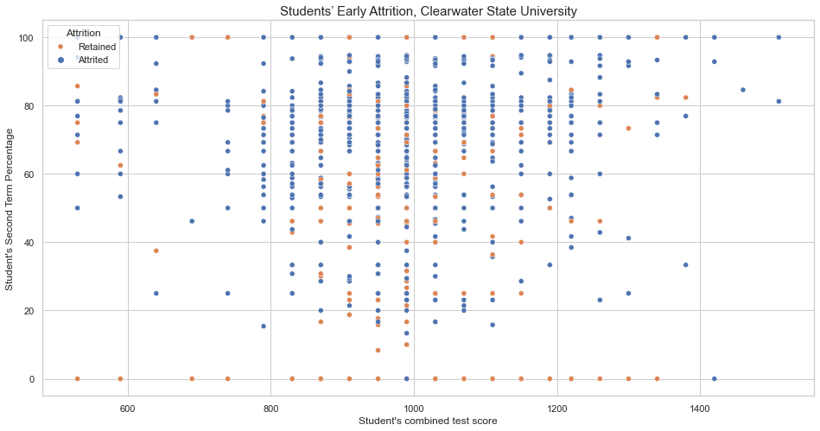
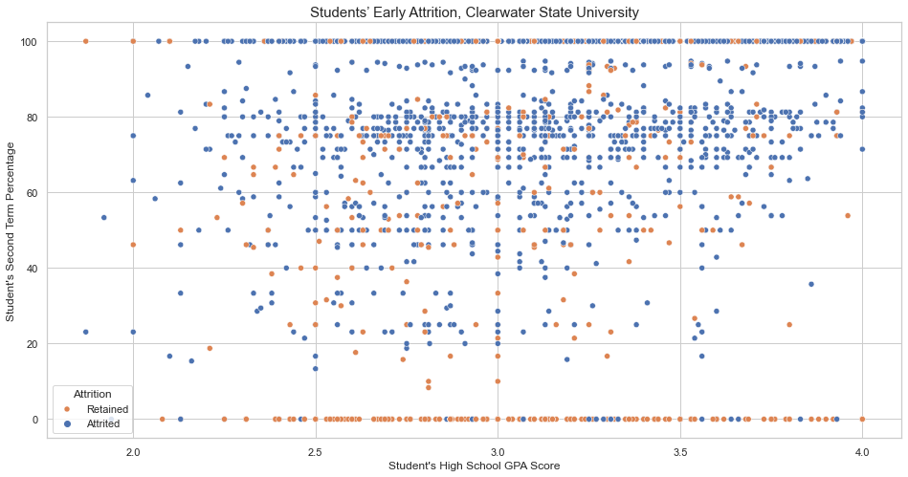
7.2 EDA: Performance Indicators

Slide 24
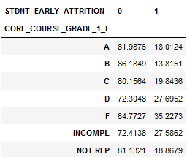
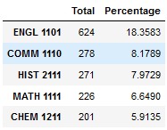
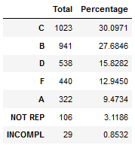






7.3 EDA: Course Preferences
Most of the students choose ENGLISH as there core course for both the semesters.
Grades: Students seems to perform good in the third core courses of each semester.
Almost 18% students choose ENGL 1101 as the first core course. 30% of the students got C in this course. Also, the rate of attrition is more among the students who got D or F or unable to complete this course.
Almost 25% students choose ENGL 1101 as the second core course. 42% of the students got B in this course. Also, the rate of attrition is more among the students who got F in this course.
Almost 33% students choose ENGL 1101 as the third core course. 51% of the students got B in this course. Also, the rate of attrition is more among the students who got D or F in this course.

Slide 25









7.3 EDA: Course Preferences
Almost 23% students choose ENGL 1102 as the first core course. 33% of the students got C in this course. Also, the rate of attrition is more among the students who got F or unable to complete this course.
Almost 31% students choose ENGL 1102 as the second core course. 46% of the students got B in this course. Also, the rate of attrition is more among the students who got D or F in this course.
Almost 42% students choose ENGL 1102 as the third core course. 60% of the students got A in this course. Also, the rate of attrition is more among the students who got D or F in this course.

Slide 26




7.4 EDA: Financial Indicators
There is not much difference between the average course fees of the students who are retained Vs. attrited.
The Estimated Family contribution towards course fees of the students who are attrited is less than that who are retained.
The Unmet financial need of the student who are attrited is greater than that who are retained.

Slide 27

7.5 EDA: Correlation
The variables UNMET_NEED & COST_OF_ATTEND are highly correlated features, thus we removed the COST_OF_ATTEND.

Slide 28
8. Data Transformation
Now that we have a clean dataset, we need to apply transformations on the data before they can be inputted to a machine learning algorithm. We will convert the categorical variables into numeric.
We have encoded the categorical variables with less than 10 categories manually and for the other categorical variables we used get_dummies functionality of the Pandas.
There were 28 variables before transformation and after transformation it became 508.

Slide 29
9. Building Prediction Models
We will test the following algorithms:
Logistic Regression: It is a supervised machine learning classification algorithm that is used to predict the output of a categorical dependent variable, based on the probabilities of achieving the output categories. In logistic regression, the dependent variable is a categorical variable.
Random Forest: It is a meta estimator that fits a number of decision tree classifiers on various sub-samples of the dataset and uses averaging to improve the predictive accuracy and control over-fitting.
Gradient Boosting: It builds an additive model in a forward stage-wise fashion; it allows for the optimization of arbitrary differentiable loss functions. In each stage n_classes_ regression trees are fit on the negative gradient of the binomial or multinomial deviance loss function.
Extreme Gradient Boosting: It is an optimized distributed gradient boosting library designed to be highly efficient, flexible and portable. It implements machine learning algorithms under the Gradient Boosting framework. XGBoost provides a parallel tree boosting (also known as GBDT, GBM) that solve many data science problems in a fast and accurate way.

Slide 30

9.1 Evaluation Of Models
We will split the data into train {70%} and test {30%}. We will then train each model of the training data and use it to make prediction. Finally, we will validate the models using the following performance metrics along with the classification report.
AUC (ROC): AUC provides an aggregate measure of performance across all possible classification thresholds. One way of interpreting AUC is as the probability that the model ranks a random positive example more highly than a random negative example.
Confusion Matrix: It is a representation of the predictions made by the classification model on a given dataset. It is a very important and useful metric in classification problems as it is not only useful to represent the models performance by itself, but can also be used to compute other metrics. A confusion matrix is composed of statistics such as true positives, true negatives, false positives, and false negatives, which are calculated using actual and predicted values.
Accuracy:
Precision:
Recall:

Slide 31



9.2 PREDICTION MODELS - Logistic Regression
The logistic regression model built on the training data had a classification accuracy of 0.8264 when used to perform predictions on the test data.
The R-square value is 0.8272.
The AUC value is 0.6809.

Slide 32



9.3 PREDICTION MODELS - Random Forest
The random forest classifier built using n_estimators=360 and random_state=227 on the training data had a classification accuracy of 0.8314 when used to perform predictions on the test data.
The R-square value is 1.00.
The AUC value is 0.7332.

Slide 33



9.4 PREDICTION MODELS - Gradient Boost
The gradient boosting classifier built using n_estimators=60, max_depth=1 and random_state=227 on the training data had a classification accuracy of 0.8343 when used to perform predictions on the test data.
The R-square value is 0.8327.
The AUC value is 0.7452.

Slide 34



9.5 PREDICTION MODELS - Extreme Gradient Boost
The XGBoost classifier built using n_estimators=80, max_depth=3, subsample=0.7 and random_state=227 on the training data had a classification accuracy of 0.8363 when used to perform predictions on the test data.
The R-square value is 0.8457.
The AUC value is 0.7392.

Slide 35



9.6 PREDICTION MODELS - Comparison
Based on the above observations, we conclude
that the random forest classifiers are good
prediction models, since it explains most of the
variability in the dataset.

Slide 36


9.7 Prediction Models - Feature Importance

Slide 37
10. Key Findings
The algorithm indicates that important academic features for student attrition are those related to the past and present educational success of the student, such as FIRST_TERM_PERCENTAGE, SECOND_TERM_PERCENTAGE, HIGH_SCHL_GPA, STDNT_TEST_ENTRANCE_COMB, CORE_COURSE_GRADE_1_S, CORE_COURSE_GRADE_2_S, CORE_COURSE_GRADE_3_S, CORE_COURSE_GRADE_1_F, CORE_COURSE_GRADE_2_F, CORE_COURSE_GRADE_3_F
The SECOND_TERM_PERCENTAGE has a great influence on the students attrition.
The HIGH_SCHL_GPA & STDNT_TEST_ENTRANCE_COMB gives insight into potential academic performance of the student at the university.
The DISTANCE_FROM_HOME have an influence on attrition, since the students who has home at a distance more than 100kms from university, on average are at more risk.
The financial indicators such as EST_FAM_CONTRIBUTION & UNMET_NEED have a negative effect on student attrition behavior.
The other variables that also have an impact on attrition are parent’s educational backgrounds namely MOTHER_HI_EDU_CD & FATHER_HI_EDU_CD.

Slide 38
11. Recommendation
The project show that, given sufficient data with the proper variables, the random forest method is capable of predicting attrition with roughly 83% accuracy.
The algorithm will help to identify the students who are at a risk of attrition and help university to intervene and improve the at-risk students who are more likely to dropout.
The university can appoint advisors to help students who does not perform well in the first year to understand students’ difficulties and develop a strategy for students success.
To improve the retention rates, institutions may choose to enroll more academically successful students. Also, monitor the academic experience & grades of the students in the first semester.
The attrition rate among the students living on campus is more may be an indicator of social and emotional connectedness as well as better integration with the culture of the institution.
We don't know the major course of 13.5% of students in the given dataset, so declaration of college major might have helped the project.
University can consider providing students financial aid based on academic achievement to achieve higher retention rates.
The students coming from another state may have less familial interaction & homesickness. The university can form service centers to facilitate cultural events for better integration with the community in the university.
The university should survey students who choose to leave the university after the first year to understand the possible reasons behind attrition.

Slide 39
Thank You.
Presentation by: Hitesh Kapade | GitHub Link

